Slide 1
Modeling Fare for Airline Routes
STA 3241
Madison Yonash

Slide 2
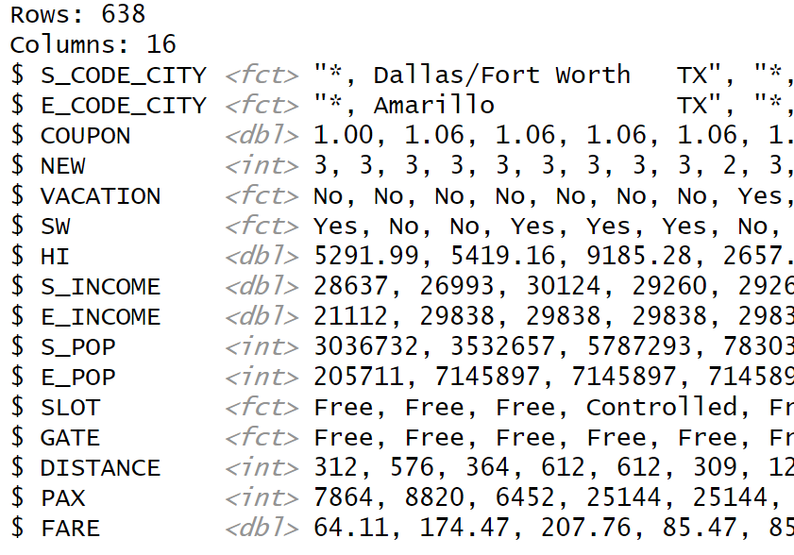
Introduction
Airfares Data
Variables Include:
DISTANCE: Distance from start to end of route
COUPON: Avg number of stops for the route
SW: If Southwest offers flights along that route
CODE_CITY: Airport code and city, either starting or ending code, city

Slide 3
Project Aims
Create a regression model to estimate fare for a pre-existing route
Create a model to estimate fare for new routes

Slide 4
Exploratory Data Analysis

Slide 5
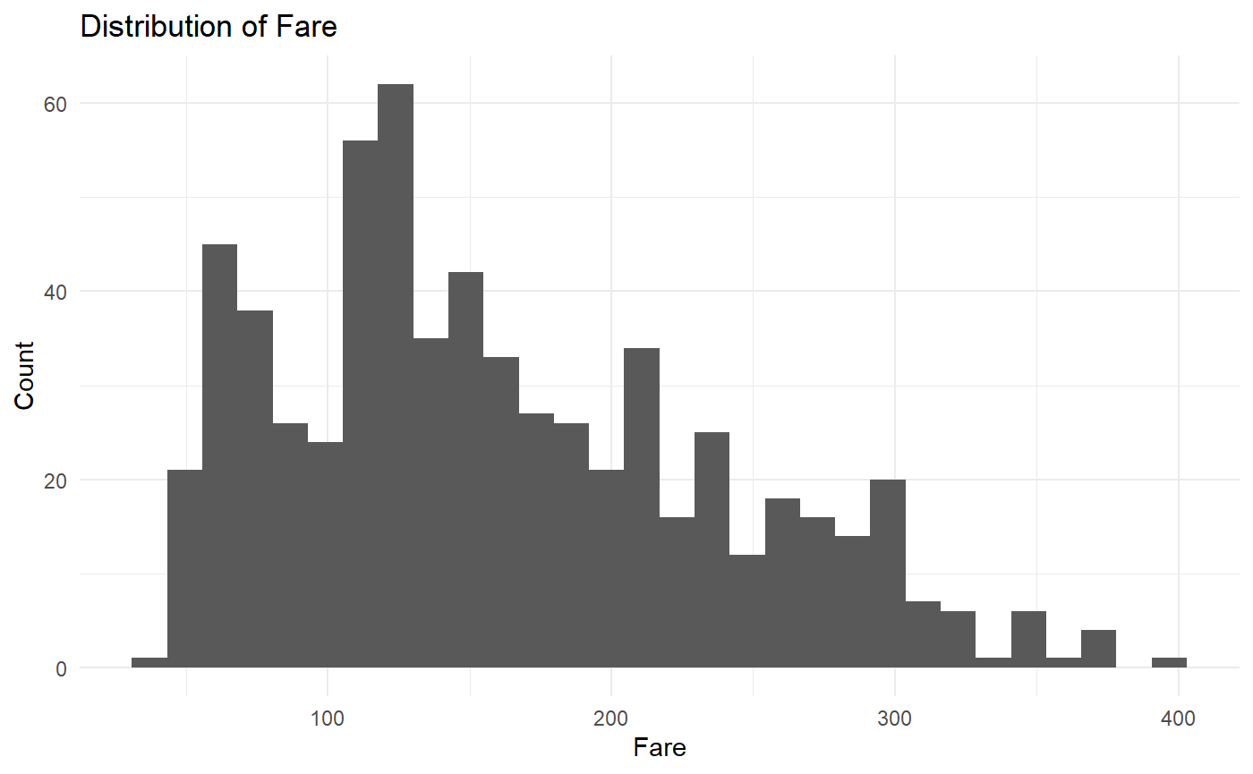
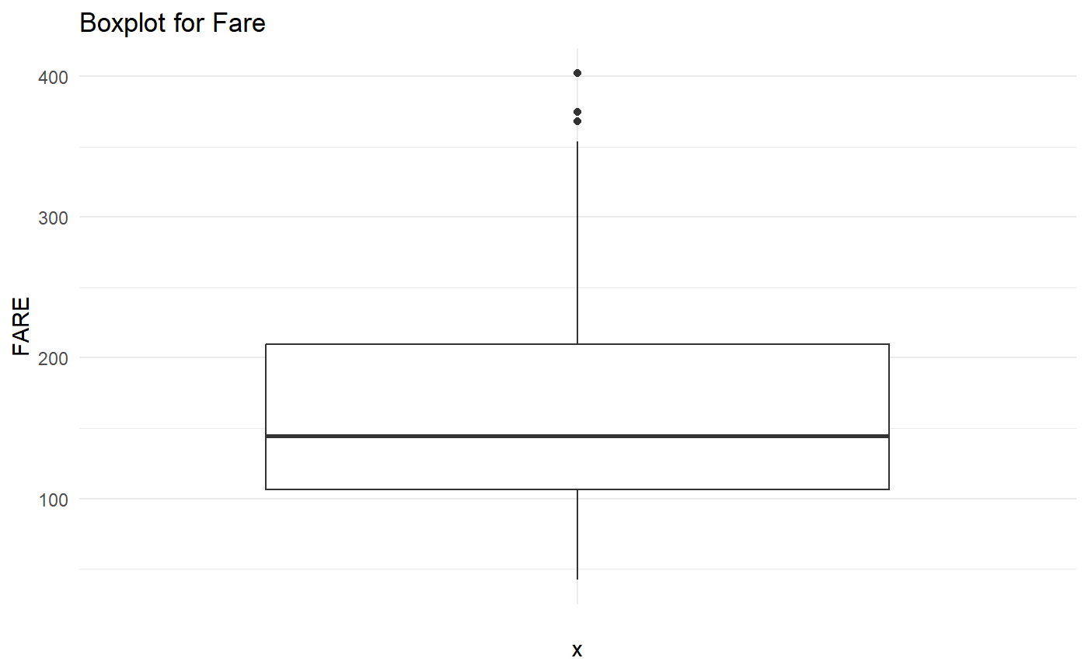
Fare

Slide 6
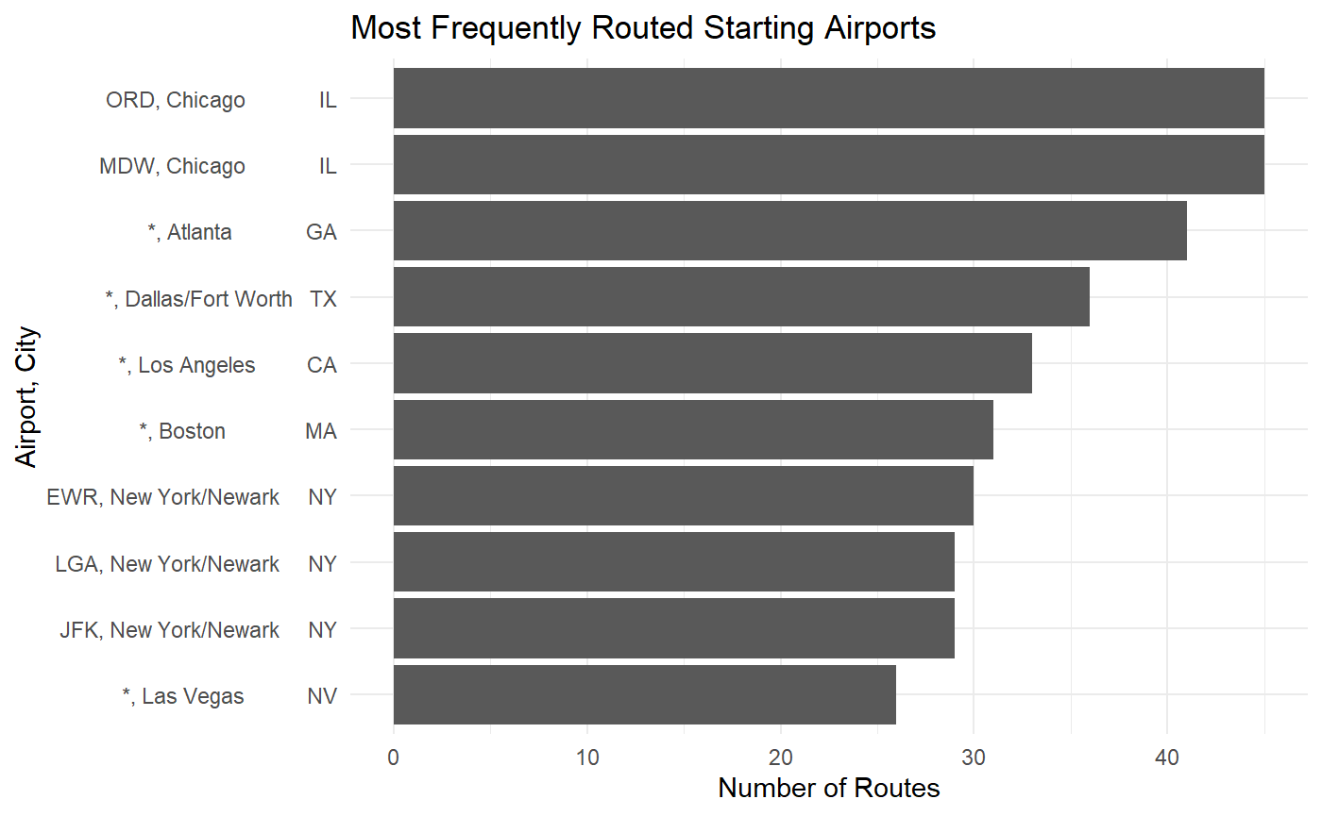
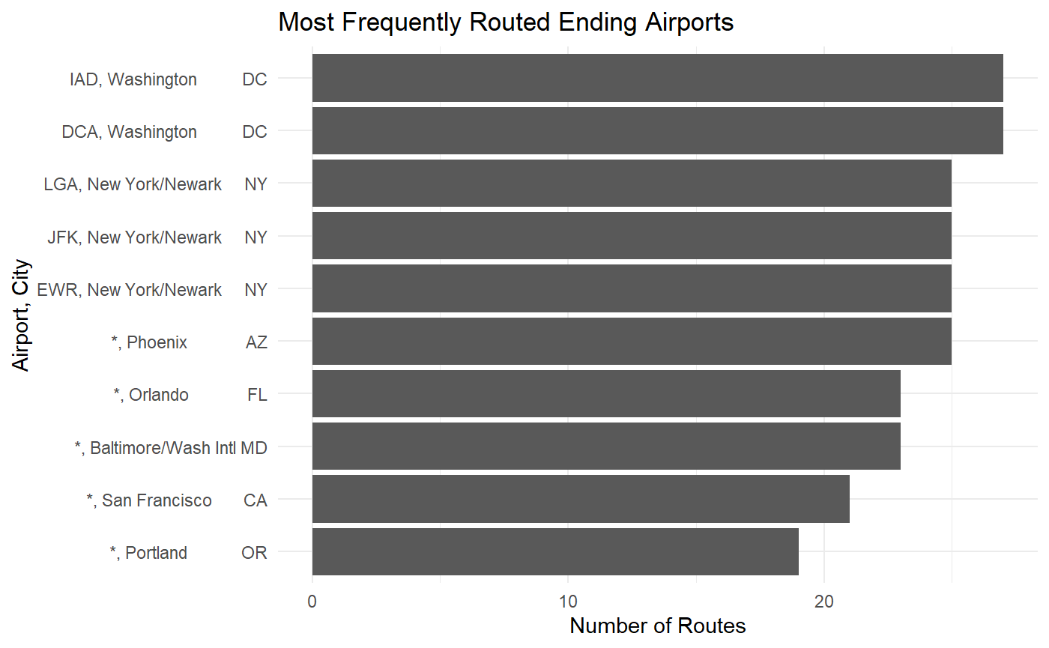
Starting and Ending Airports, Cities

Slide 7
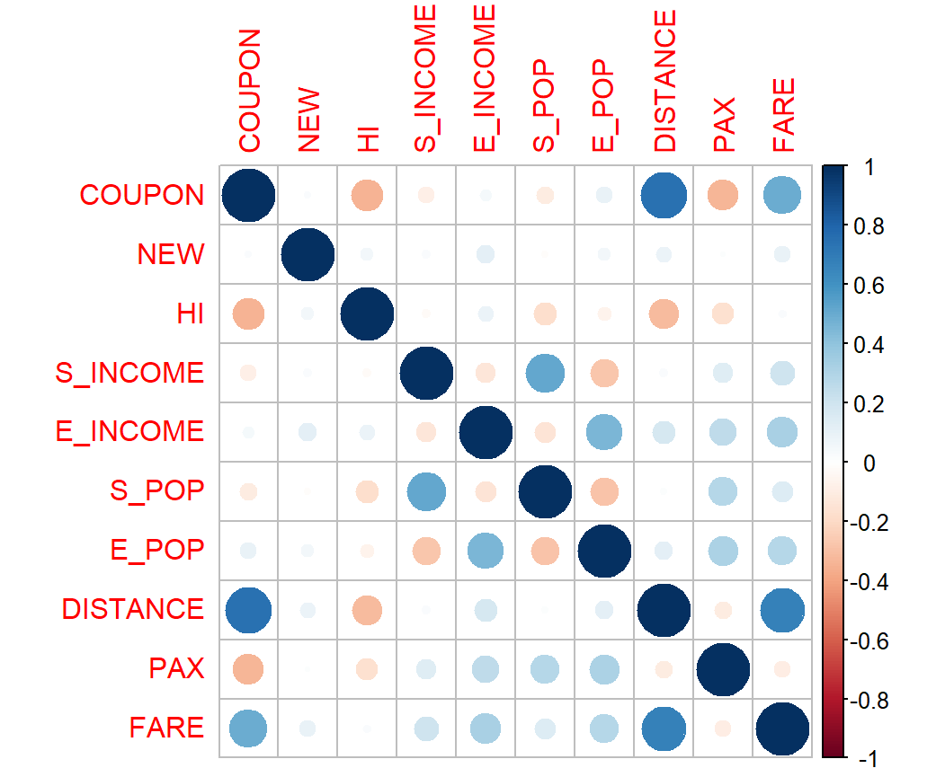
Correlation Matrix
Examining the numerical predictors in our dataset

Slide 8
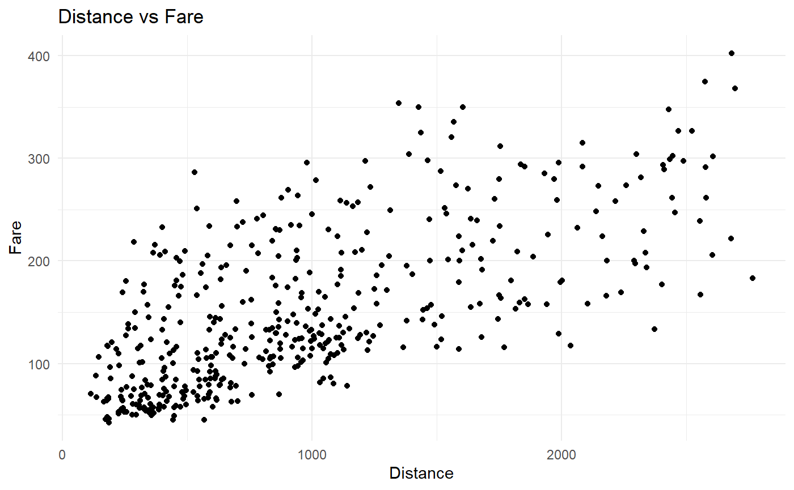
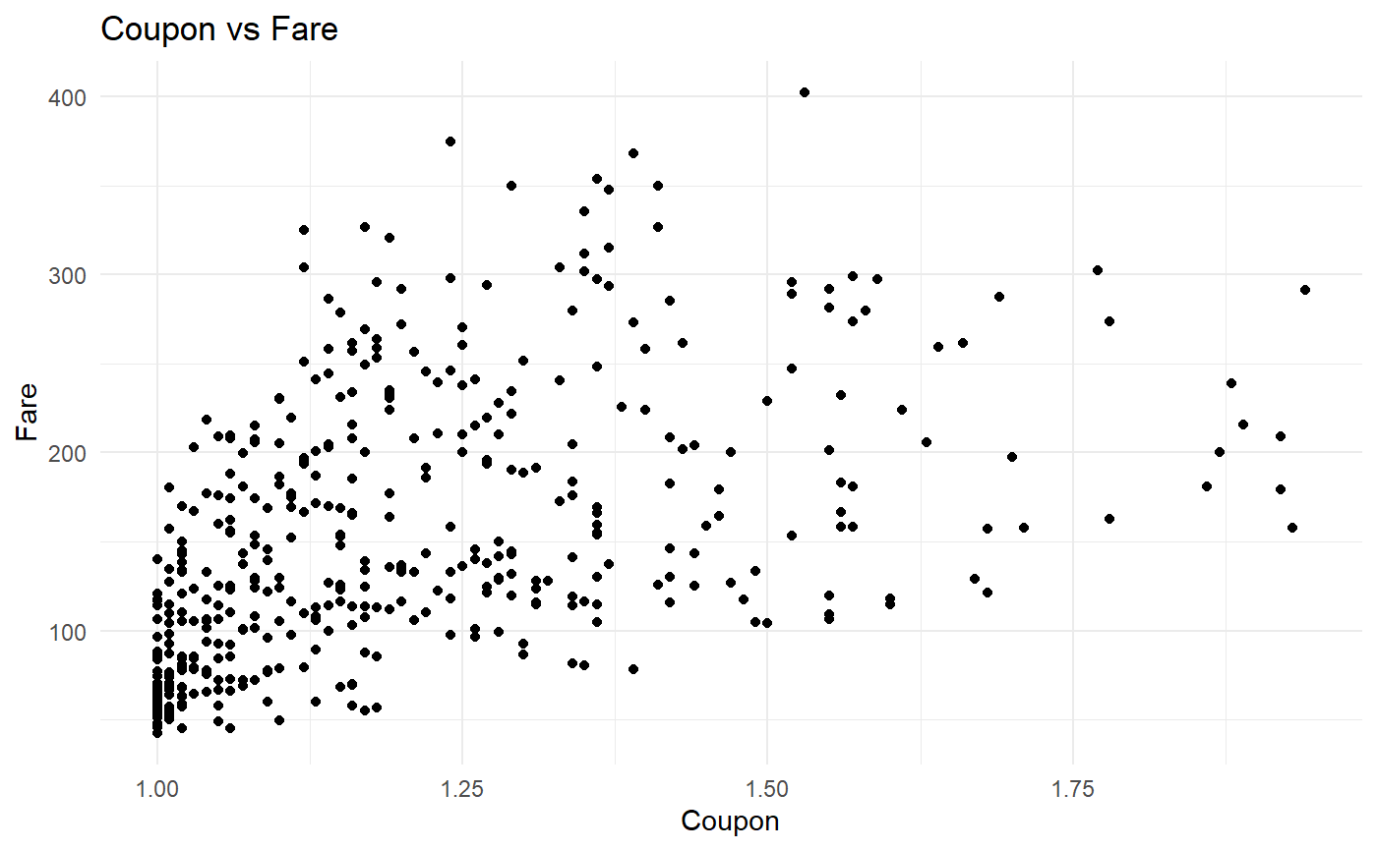
Fare and Numerical Predictors

Slide 9
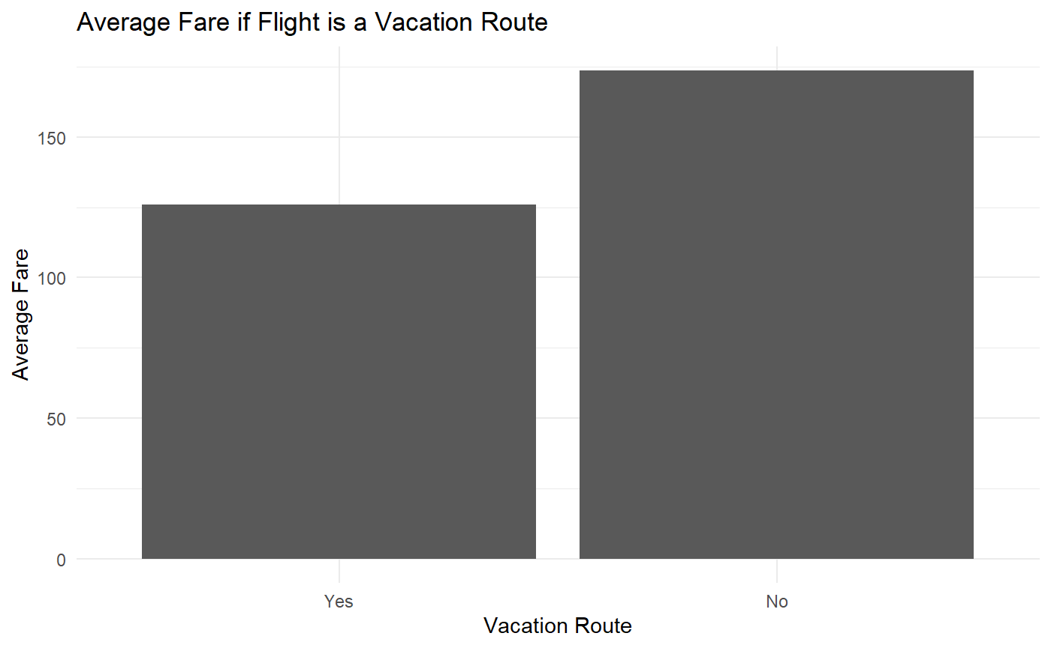
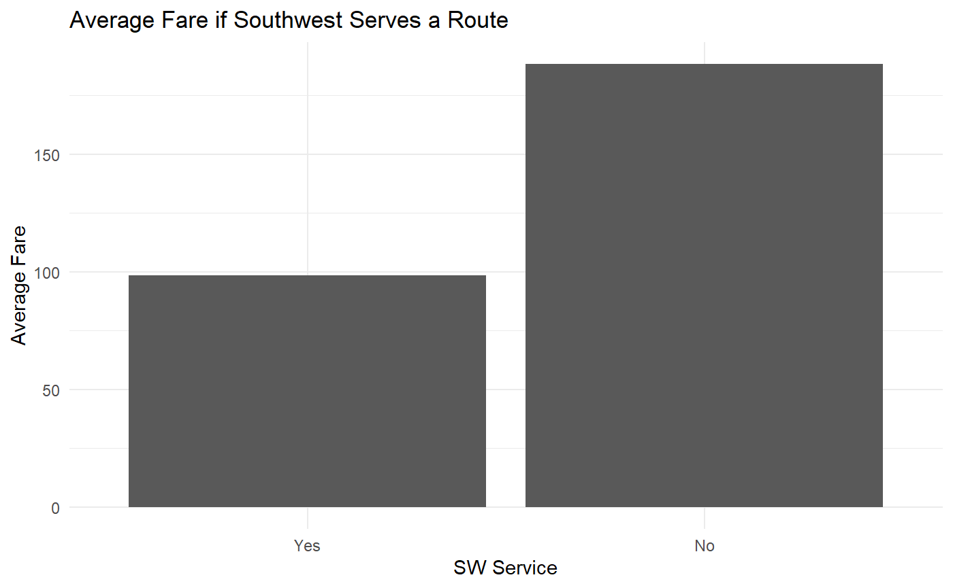
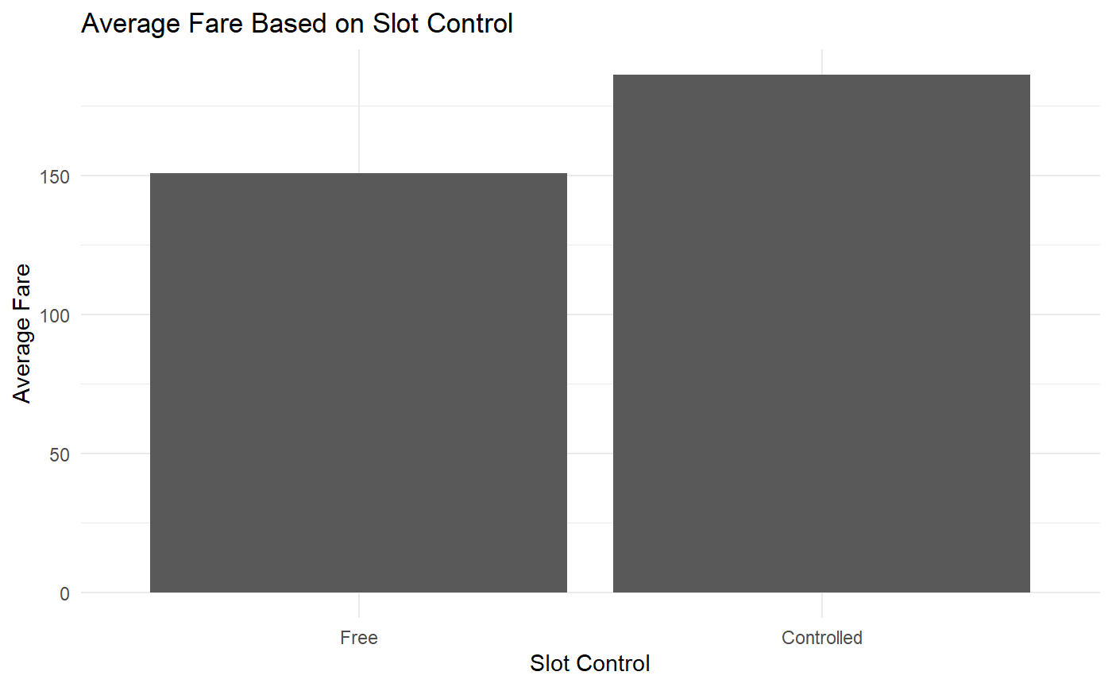
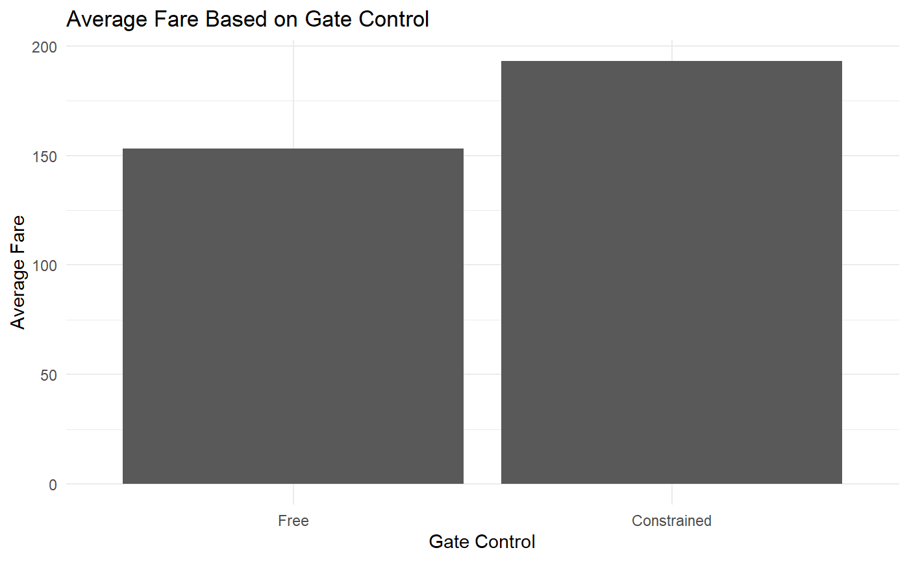
Fare and Categorical Predictors

Slide 10
Methods
Techniques used:
Linear Regression
Logistic Regression
Ridge Regression
Lasso Regression
Random Forest
Support Vector Machine
Supervised learning techniques to perform regression to estimate route fare
Perform 5-fold cross validation on each model
Perform stepwise selection on linear and logistic regression to reduce number of predictors
Evaluate models by examining R², in-sample MSE, and out-of-sample MSE

Slide 11
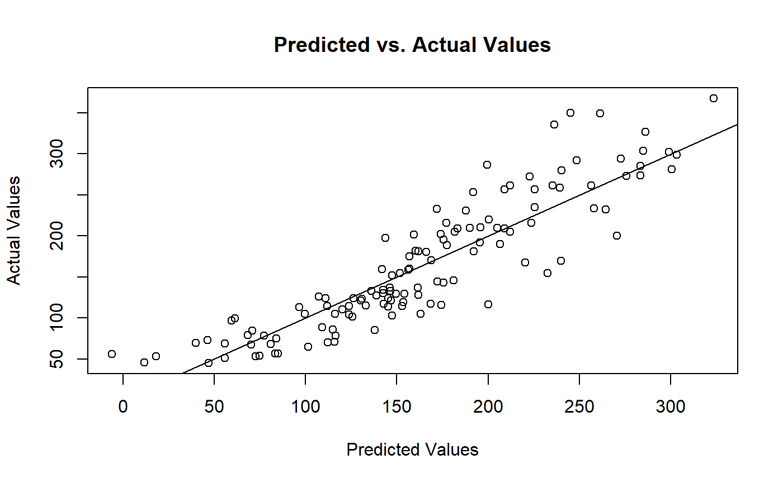
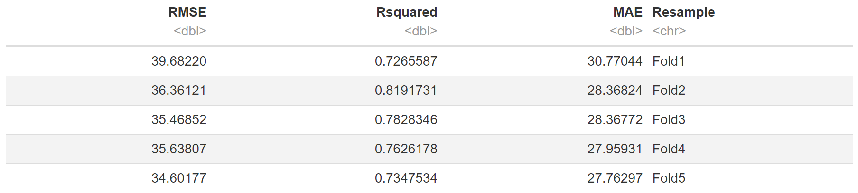
Linear Regression

Slide 12
Logistic Regression

Slide 13
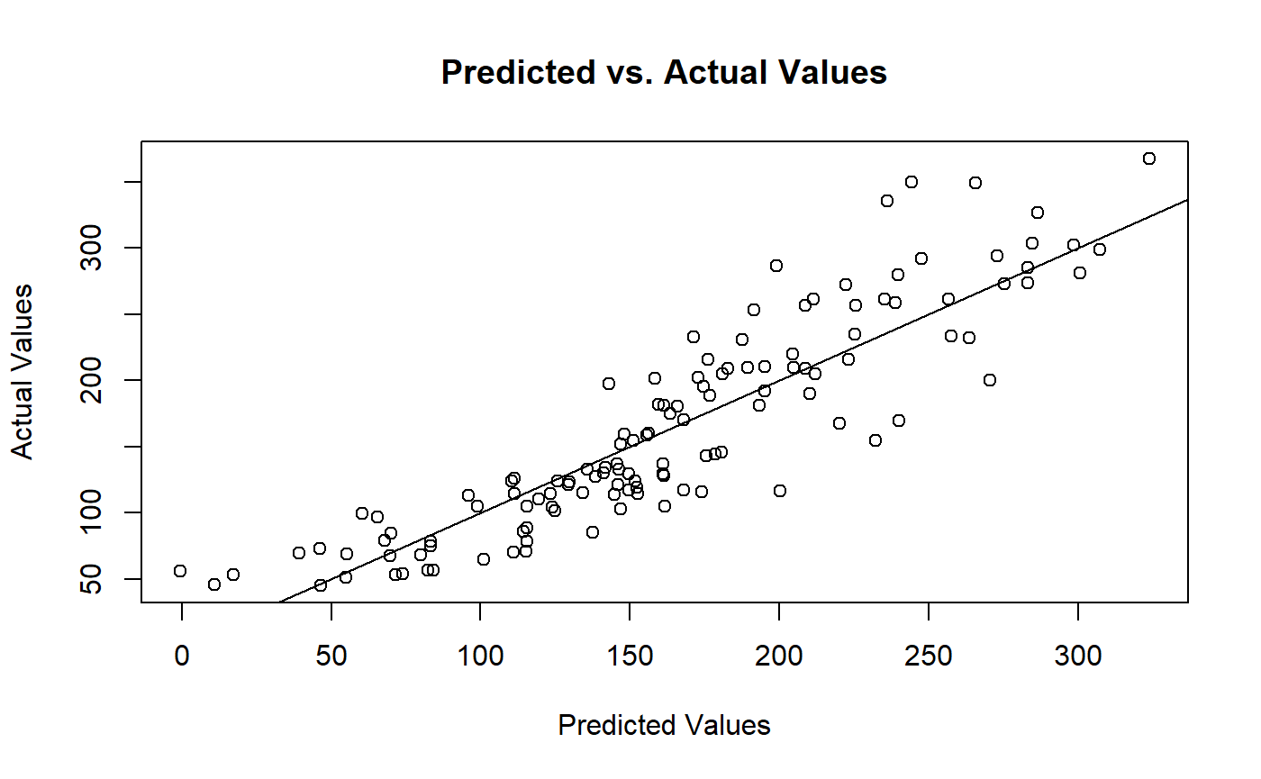
Ridge Regression

Slide 14

Lasso Regression

Slide 15
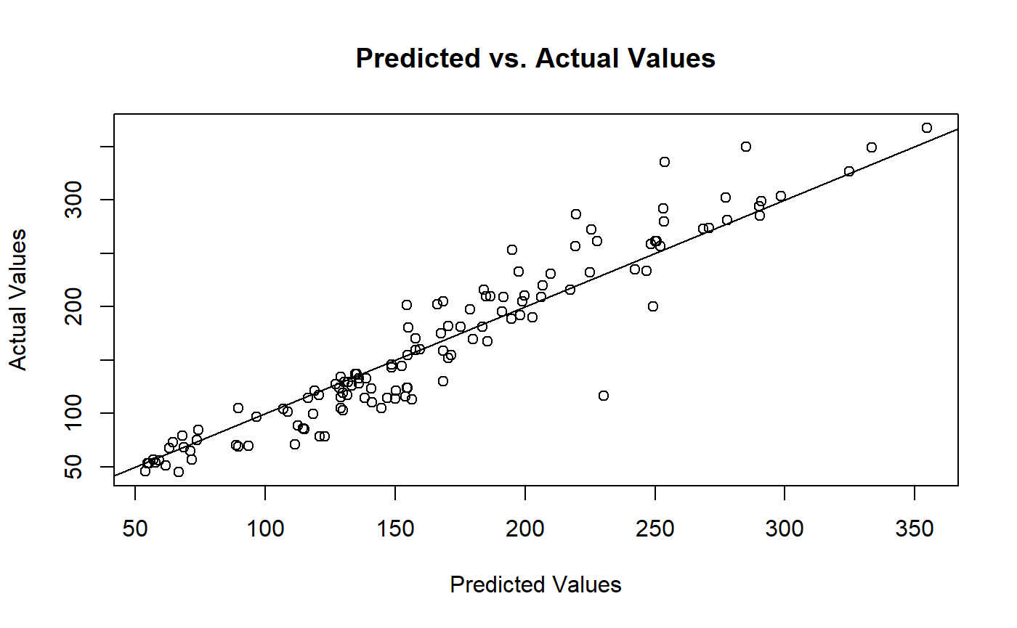
Random Forest

Slide 16

Support Vector Machine

Slide 17
Comparing Models
Model | R² | In Sample RMSE | Out of Sample RMSE
Linear | 0.7669 | 36.137 | 34.5521
Logistic | 0.7697 | 36.419 | 34.5521
Ridge | 0.7706 | 35.886 | 34.4968
Lasso | 0.7651 | 36.341 | 35.336
Random Forest | 0.8810 | 26.651 | 25.232
SVM | 0.7696 | 36.3103 | 34.612

Slide 18
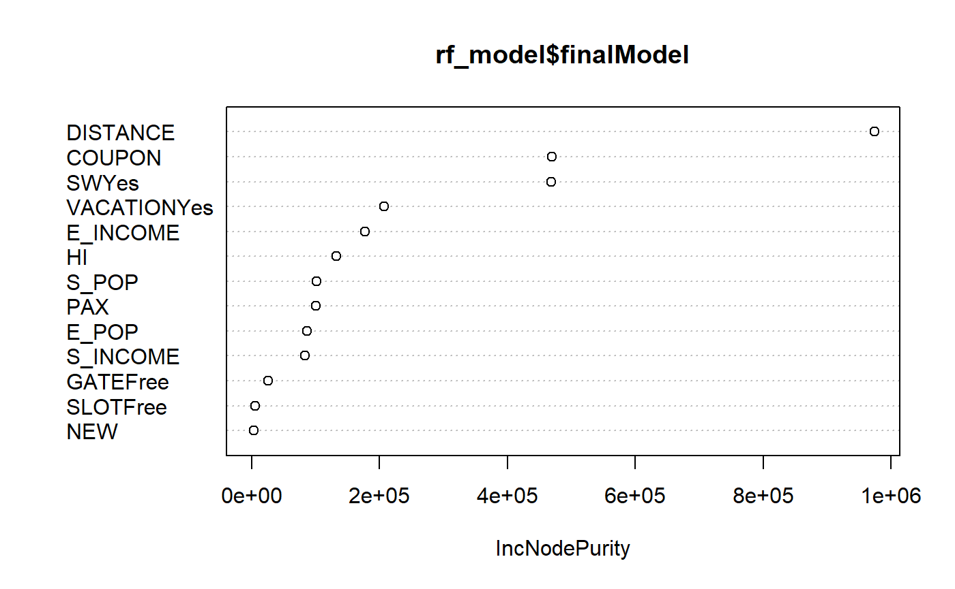
Random Forest Variable Importance Plot

Slide 19
Model to Estimate Fare for New Routes
Variables omitted:
NEW
HI
PAX
Implementing random forest for regression as it performed the best in the initial test
Omitting variables that we will not have before a route is offered
Aim is to create a model an airline could use when trying to set a fare for a new route being offered

Slide 20
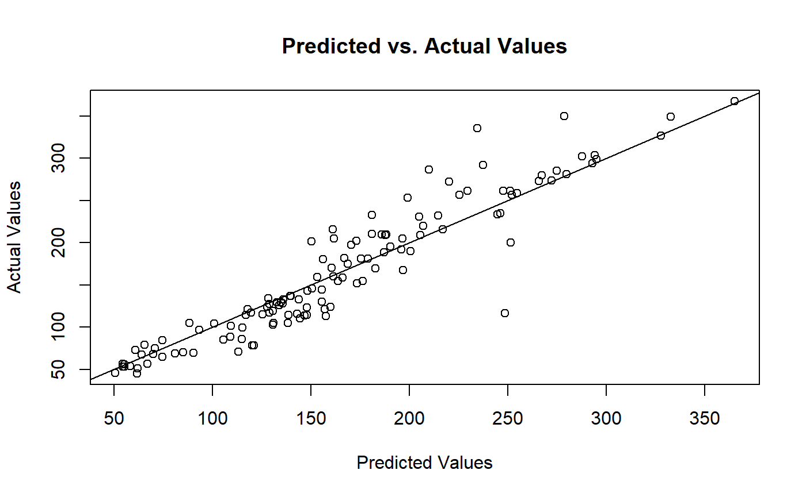
Model to Estimate Fare for New Routes

Slide 21
Comparing Models
Model | R² | In Sample RMSE | Out of Sample RMSE
All Predictors | 0.8810 | 26.651 | 25.232
Only Pre-Existing Predictors | 0.8723 | 27.139 | 27.547

Slide 22
Conclusion, Limitations, and Future Research
The different models used to predict fare had relatively similar results in their accuracy, and their ability to predict unseen data
Exploring the use of a random forest model to predict fare for a route that has not yet been created expands applications of this project
Major limitation for this project was the inability to use airport/city as predictors
Find a larger data set with a wider range of airports and more routes offered at each airport and city

Slide 23
Conclusion, Limitations, and Future Research
We now have many more budget airlines such as Spirit and Frontier offering low-cost alternatives
Explore if certain routes that have lots of budget airline activity have a lower fare (ie, the function of Southwest in this dataset)
Route fare today versus the past, examining time series data for how fare has changed and how it may change in the future
Examine fare with different airline offerings as well as seasonality

Slide 24
Thanks! Questions?

